Slide 1
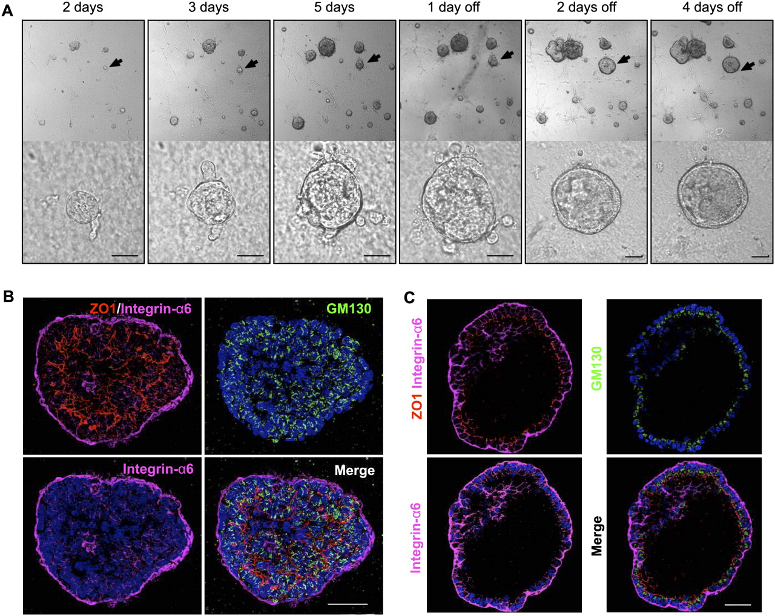

Single tritransgenic cell exposed to a doxycycline form solid, depolarized spheres that regresses to a repolarized rim upon doxycycline withdrawal.
Jechlinger M et al. Genes Dev. 2009;23:1677-1688
©2009 by Cold Spring Harbor Laboratory Press
Notes:
Single tritransgenic cell exposed to a doxycycline form solid, depolarized spheres that regresses to a repolarized rim upon doxycycline withdrawal. (A) Bright-field pictures taken at indicated time points follow a typical field with representative cell aggregates over a time course of 9 d. Doxycycline treatment was started at the single-cell stage 8 h after seeding cells into the 3D matrix. (Top panels) Pictures show solid growth of aggregates upon doxycycline treatment and clearance of internal cells after doxycycline withdrawal; the arrow indicates the single structure that is shown in the bottom panels. Bar, 30 μm. (B) Confocal microscopy shows the distribution of markers for epithelial polarity in a typical aggregate grown from a single tritransgenic cell for 4 d in the presence of doxycycline. A 5-μm projection through the middle of the sphere shows several smaller lumina lined by ZO1 staining and otherwise depolarized cells. (Blue) DAPI stain; (green) GM130; (red) ZO1; (magenta) Integrin α6. Bar, 40 μm. (C) Confocal microscopy shows a typical repolarized single-cell-layered sphere that survives doxycycline withdrawal; 5-μm projection through the middle of the sphere that was fixed and stained 5 d after removal of doxycycline. (Blue) DAPI stain; (green) GM130; (red) ZO-1; (magenta) Integrin α6. Bar, 40 μm.

